Slide 1
CPE 133
Review
Parity Checkers and Generators
Experiment 6 Introduction

Slide 2
Experiment 5
Use comp_nb.v without modifications
Instantiate two 4-bit comparators
Include timing diagram printout
Screen capture
Invert image in Paint
Print
Annotate
Read sections on annotations

Slide 3
Foundation Modules (thus far)
RCA
Comparator
Generic Decoder
Standard Decoder
4:1 MUX

Slide 4
Stuff to know
RCAs
They’re dumb, they add bits
Comparators
Only work with unsigned binary
LT ➔ a < b , GT ➔ a > b
Control inputs
MUXes, standard decoders
Status outputs
RCAs, Comparators

Slide 5
Verilog Modeling
General Verilog Model
Boxes exchanging signals with boxes
Boxes working concurrently
Boxes could be
Instantiated objects (structural modeling)
Procedural blocks (always statements)
continuous signal assignment statements
Keep boxes “uncomplicated”
Keep separate ideas in separate boxes
Don’t try to stuff too much in a box
Hard to debug
Synthesizer can be flaky

Slide 6
Parity
Straight forward
Count the “set” bits in a group of bits
Could be serial or parallel
If count is odd number: odd parity
Otherwise: even parity (even or zero bits set)
No relation to even and odd numbers
No relation to “format” of bits
It’s just number of set bits
Similar to hexadecimal representation of bit

Slide 7
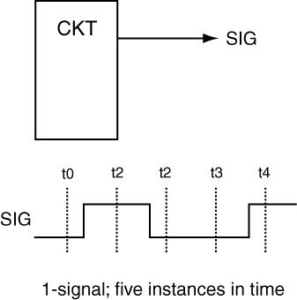
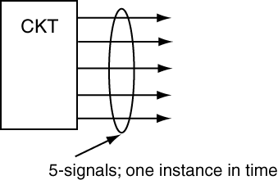
Data Transmission
Serial vs. Parallel
Parallel
Serial

Slide 8
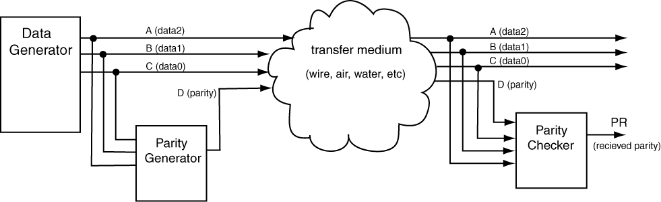
Parity Generator/Checker

Slide 9
Design Example
Design a circuit that imposes even parity on three input bits by including one output bit with the three input bits.

Slide 10
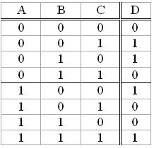
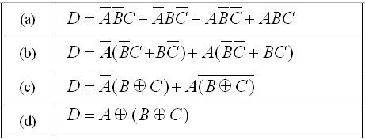
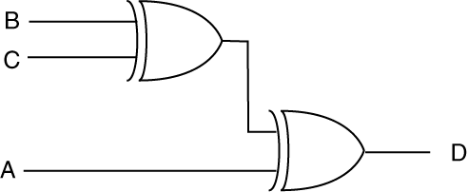
Parity Generator (even)

Slide 11
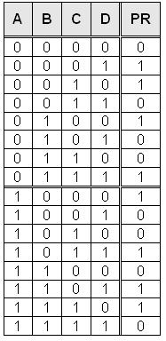
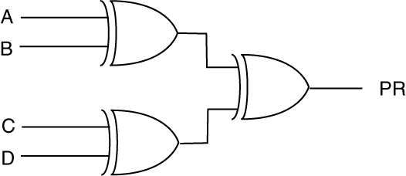

Parity Generator

Slide 12
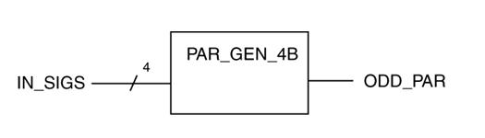
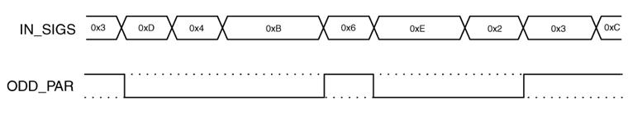
Parity Generator Example
Use the block diagram to complete the following timing diagram.

Slide 13
Parity Generator Foundation Module
Parity Generator

Slide 14
Summary
Parity
Used in transmission protocols
1-bit error detection
Three IMD-based devices
RCA
Comparator (XOR-based)
Parity generator (XOR-based)

Slide 15
Experiment #6: 5-Bit Magnitude Comparator
Compares magnitude of two 5-bit RC numbers
Displays value
Special instructions (read lab manual)
Uses univ_sseg.v module
Multiplexes 7-seg display
Negative numbers
Valid (number) or not valid (dashes)
Use provided RCA
Don’t modify
Instantiate to the data width you need

Slide 16
univ_sseg.vhd Module
Read file banner for details
cnt1: 14-bit unsigned binary number
cnt2: 7-bit unsigned binary number
sign: puts ‘-’ sign in left-most display
valid: puts “- - - -” on display
dp_en: enables decimal point
dp_sel: select decimal point locale
mod_sel: selects display mode
clk: system clock
segments: cathodes for display
disp_en: anodes for display

Slide 17
Design Approach
Design on paper first
Define modules, data paths, & controls
Decompose into parts
Magnitude comparison
Display issues: control of sign & valid
Consider using BFD
Keep modules simple (not multi-purpose)
Use many simple modules, not few complicated modules

Slide 18
Example Problem
Design a circuit that outputs either A + B (addition) or 2A (multiplication). If both input values are evenly divisible by 4 and less than 128, then output the addition result; otherwise, output the multiplication result. The output should be wide enough so that it is always valid. Assume inputs and outputs are unsigned 8-bit binary numbers.
Provide two levels of BBDs
Don’t use a comparator in your design
Minimize hardware in your design
State how circuit is controlled

